Slide 1

CMPE/SE 257 Machine Learning Feb 19
Department of Computer engineering
San José state University
Spring 2018
Instructor :Bhavana Bhasker

Slide 2
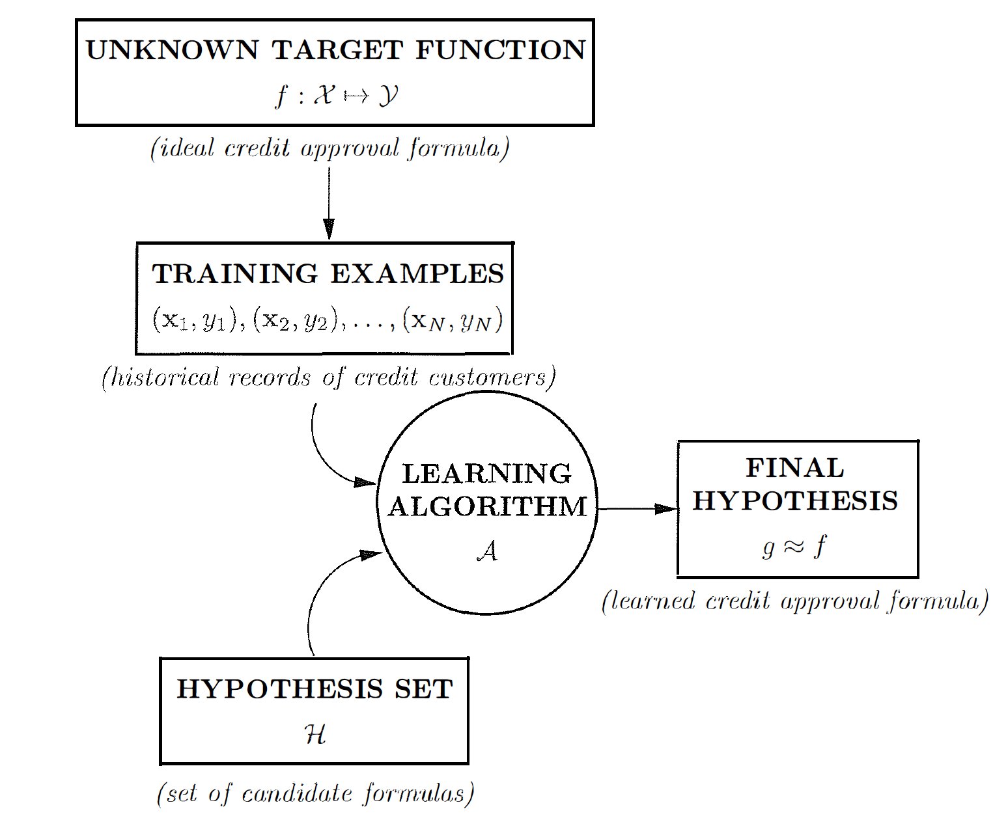
Basic setup of the learning problem

Slide 3
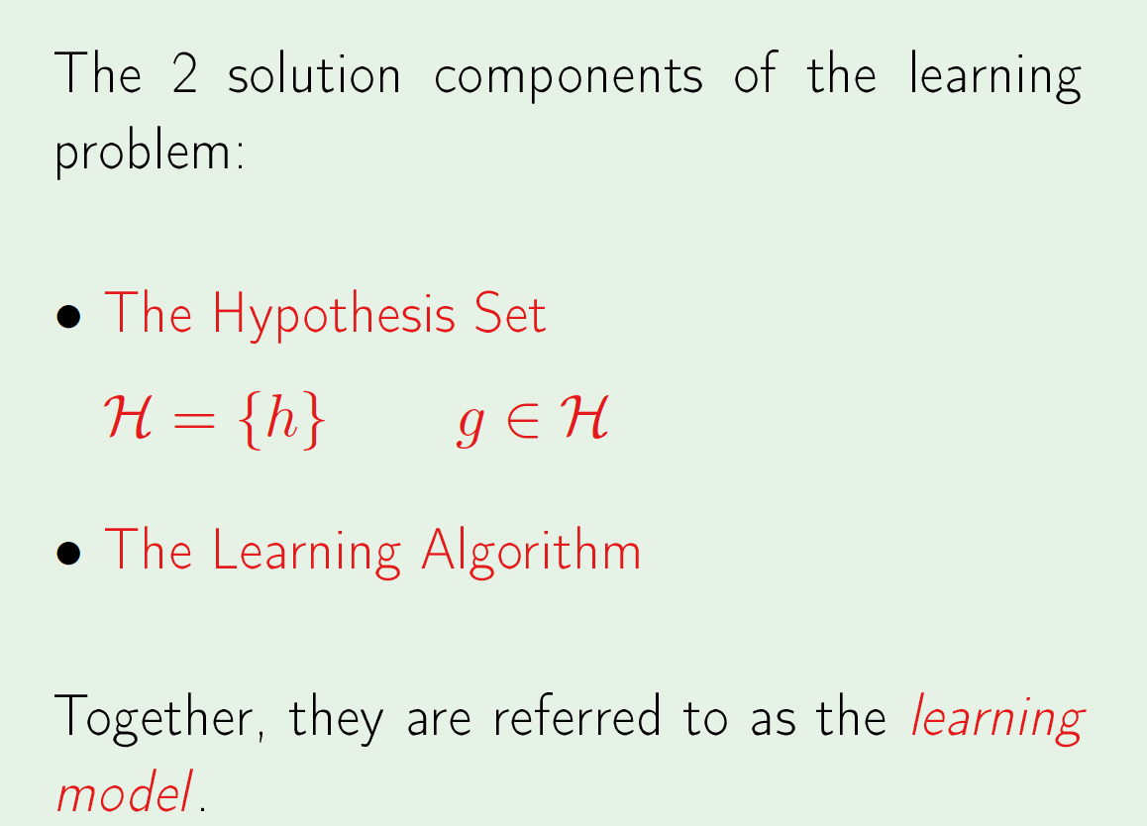
Basic setup of the learning problem

Slide 4
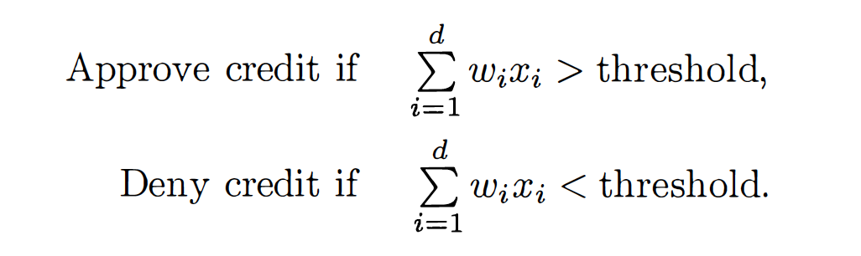
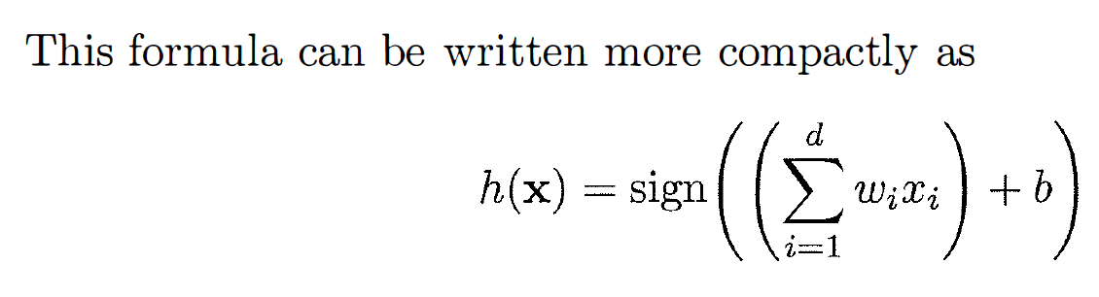
The ‘PERCEPTRON’
For input x = (x _{i} , ··· , x_{d}). ‘attributes of a customer’

Slide 5
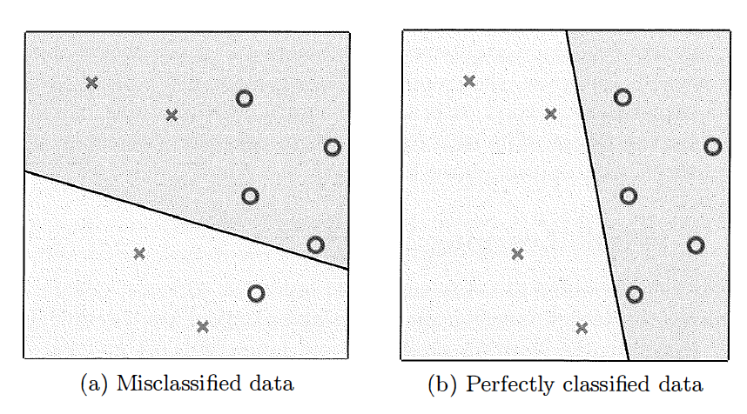
The ‘PERCEPTRON’

Slide 6
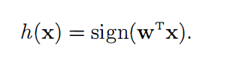
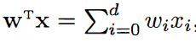
Perceptron Learning Algorithm (PLA)
Let the input space be,
Bias -> w₀ = b
Weight vector w = [w0, w1 , · · · , wd]^{T}
X = [x0, xi, · · · , xd]^{T}

Slide 7
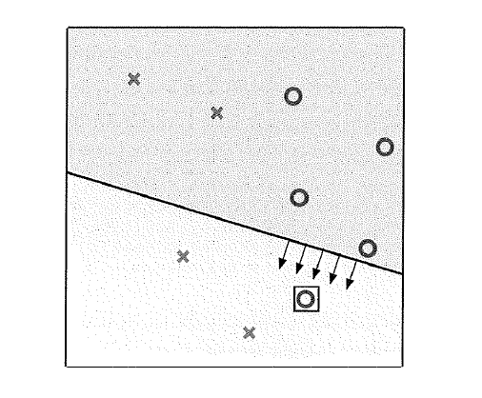
Perceptron Learning Algorithm (PLA)
Update Rule
w(t + 1) = w(t) + y(t)x(t)

Slide 8
Types of learning
Supervised learning
Unsupervised learning
Reinforcement learning

Slide 9
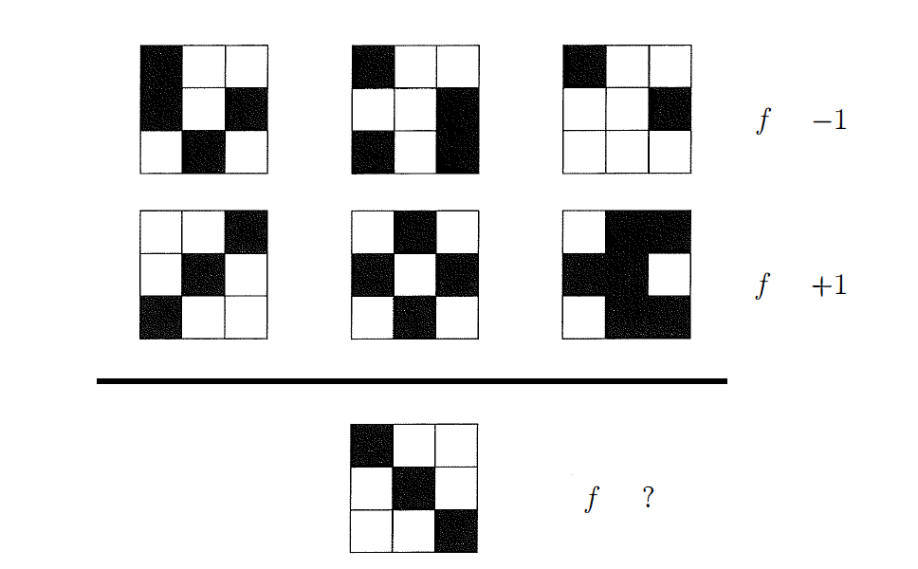
Is learning feasible?

Slide 10
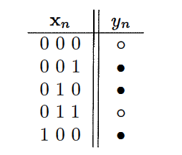
Outside the Data Set: Unknown Target Function

Slide 11
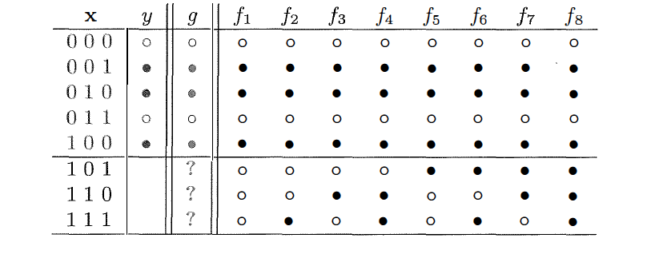
Outside the Data Set: Unknown Target Function

Slide 12
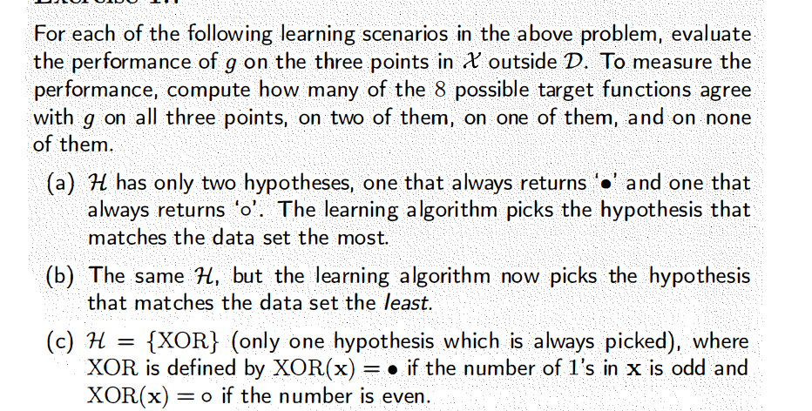
Outside the Data Set: Unknown Target Function

Slide 13
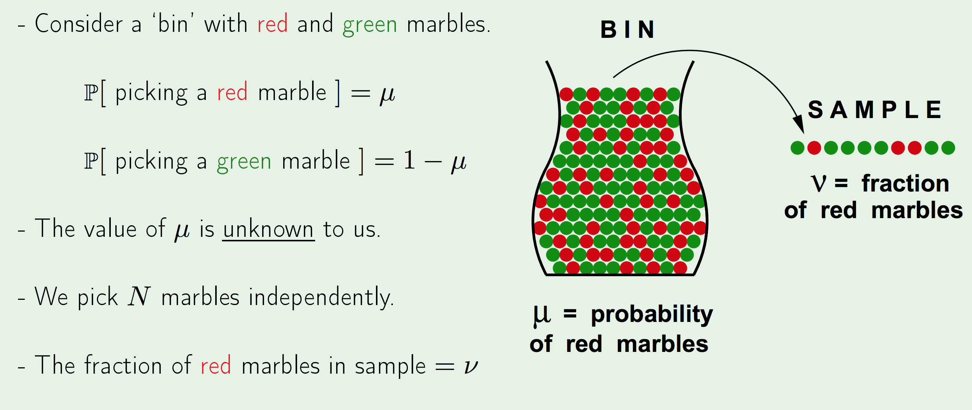
Hoeffding’s Inequality

Slide 14
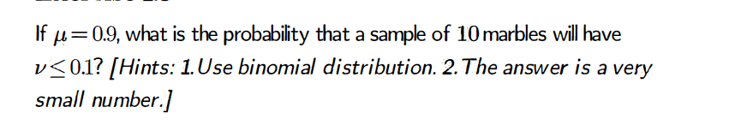
Hoeffding’s Inequality

Slide 15
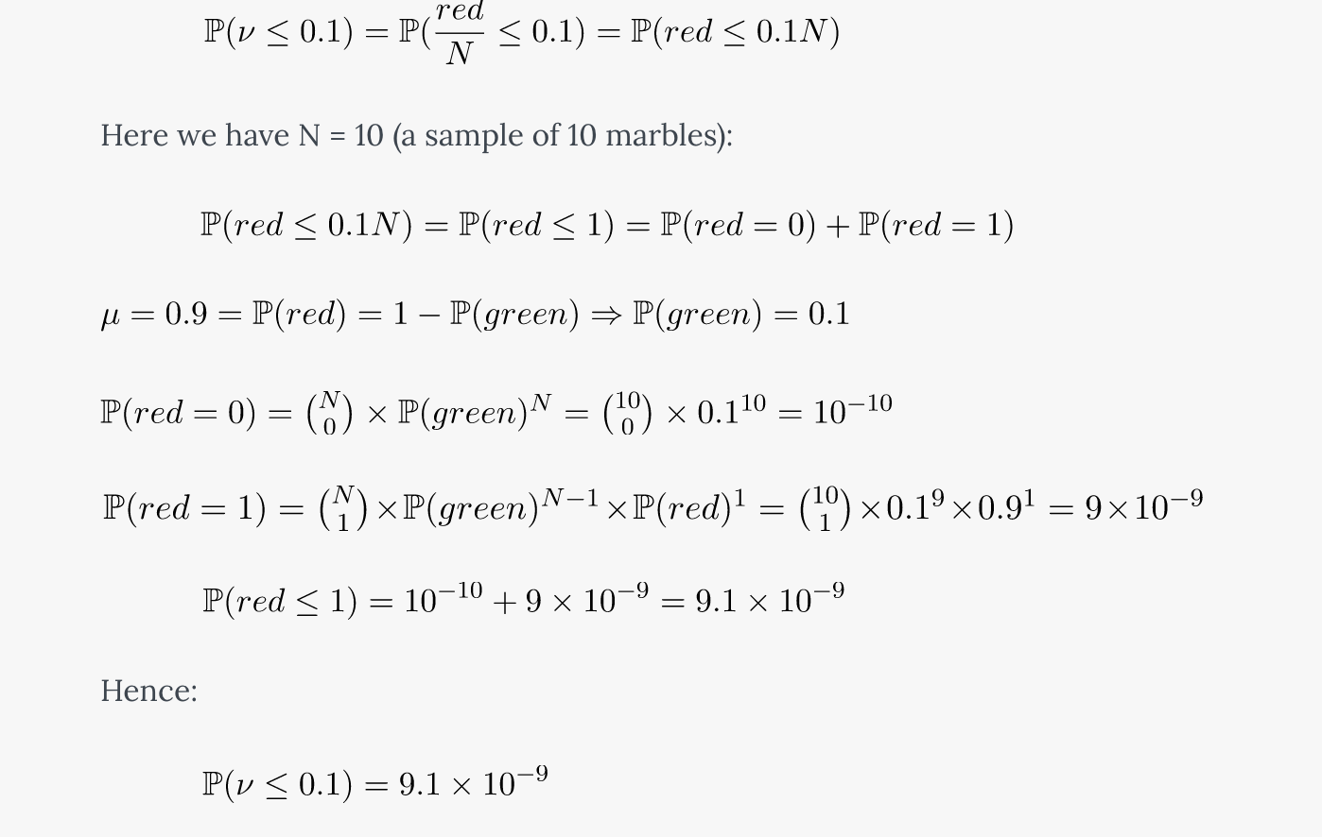
Hoeffding’s Inequality

Slide 16
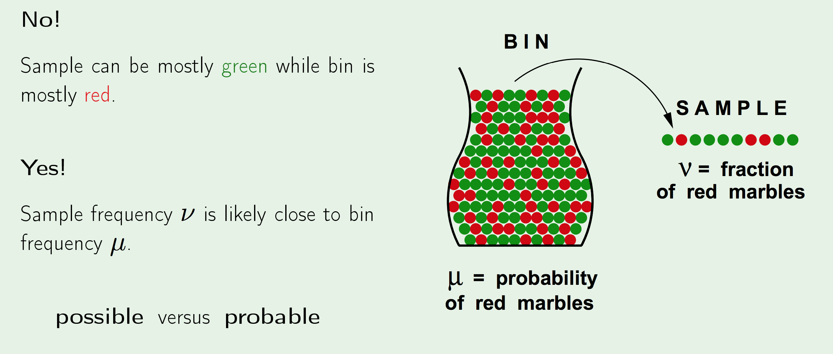
Hoeffding’s Inequality : Does v say anything about µ?

Slide 17
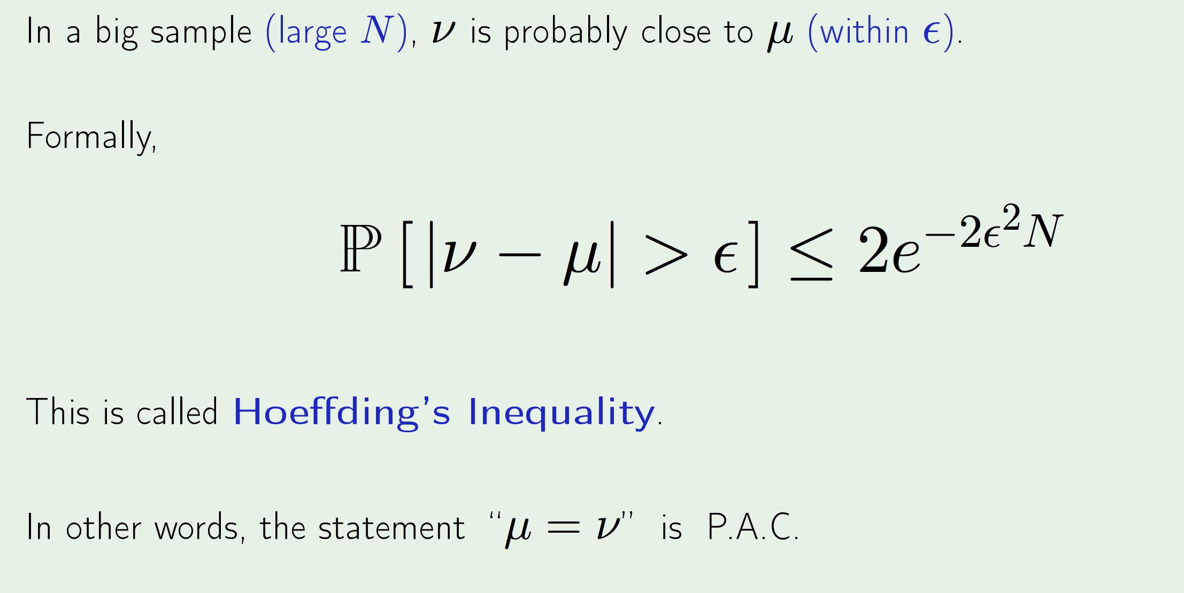
Hoeffding’s Inequality : What does v say about µ?

Slide 18
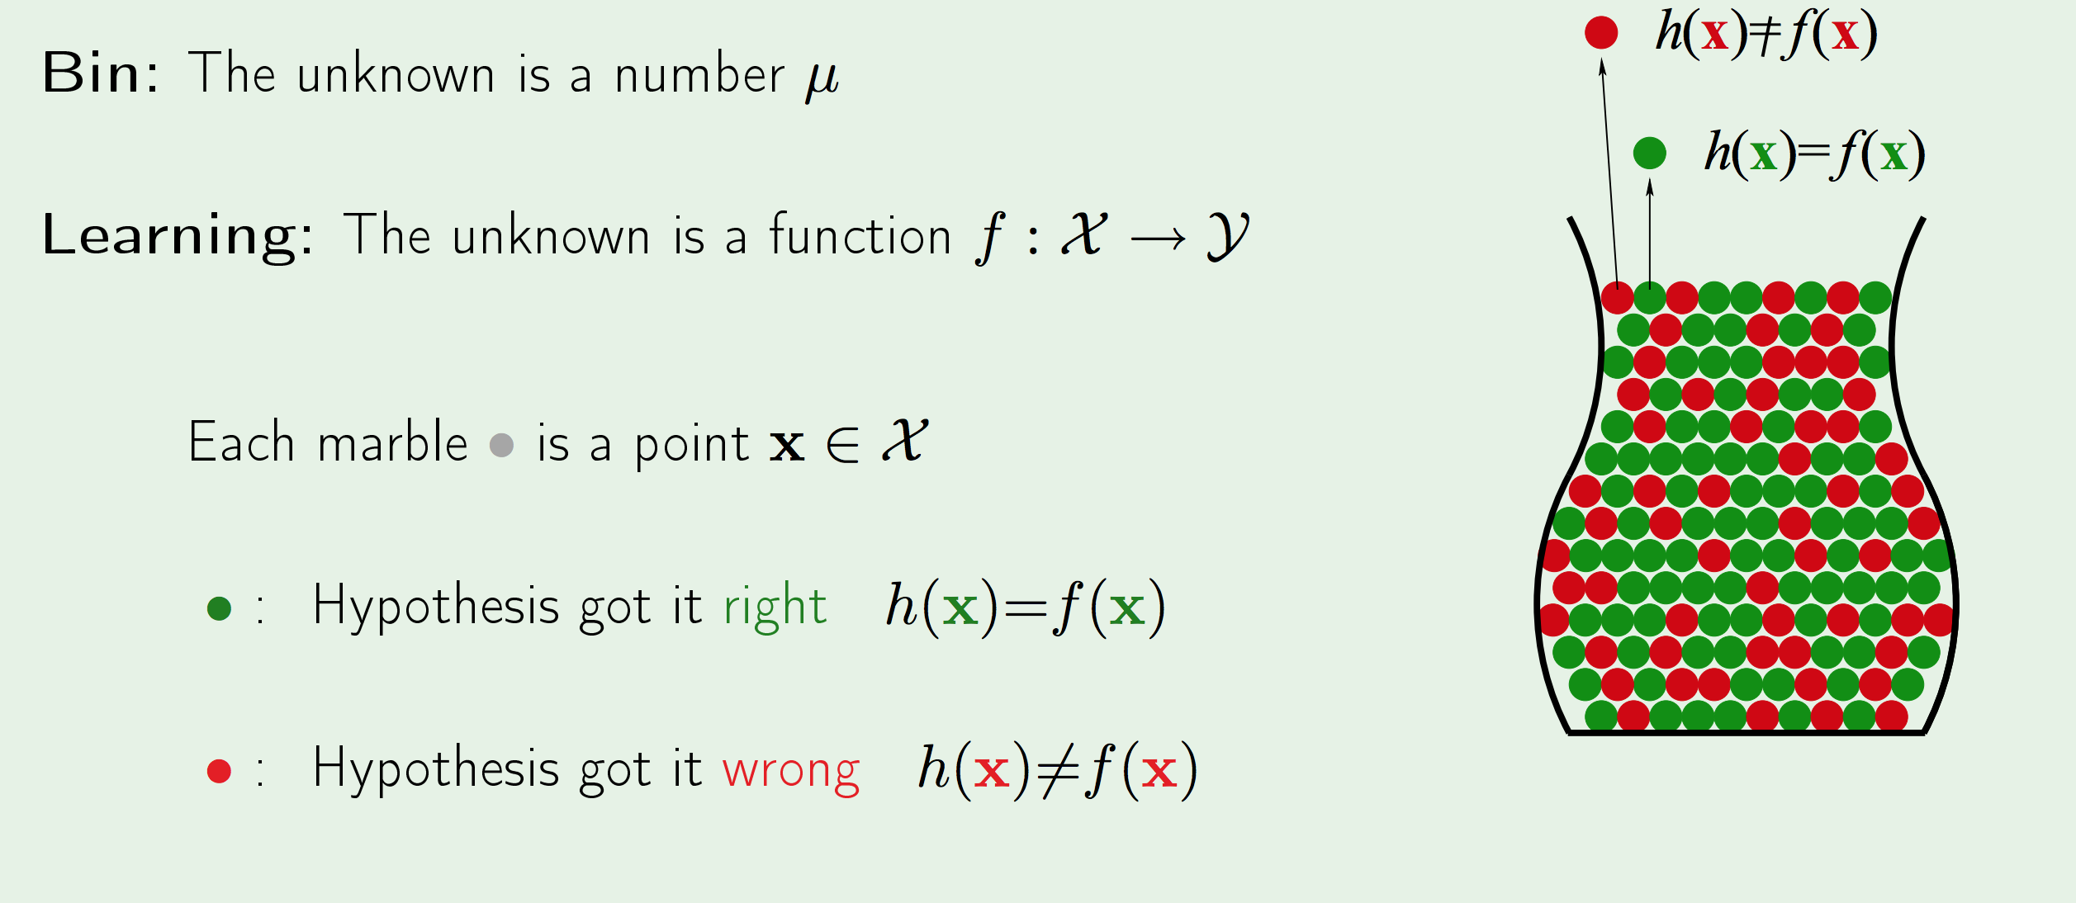
Hoeffding’s Inequality : Connection to learning

Slide 19
Hoeffding’s Inequality : Connection to learning

Slide 20
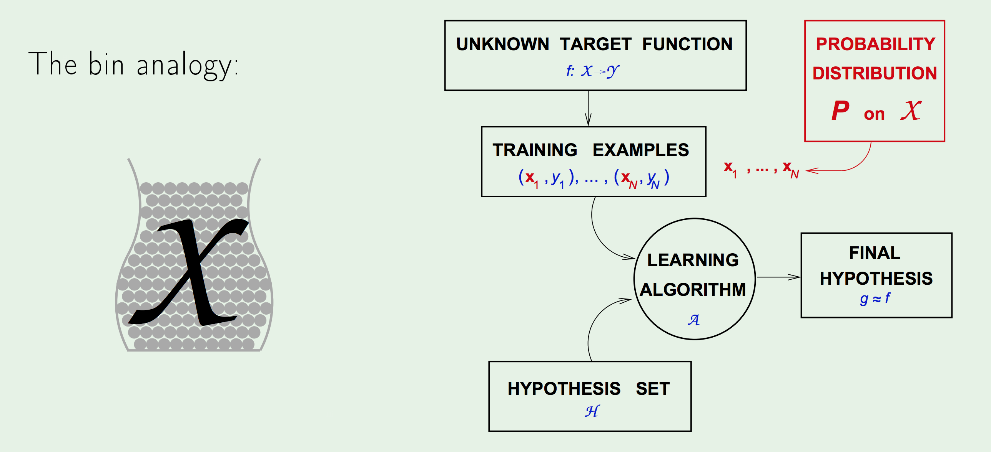
Hoeffding’s Inequality : Connection to learning

Slide 21
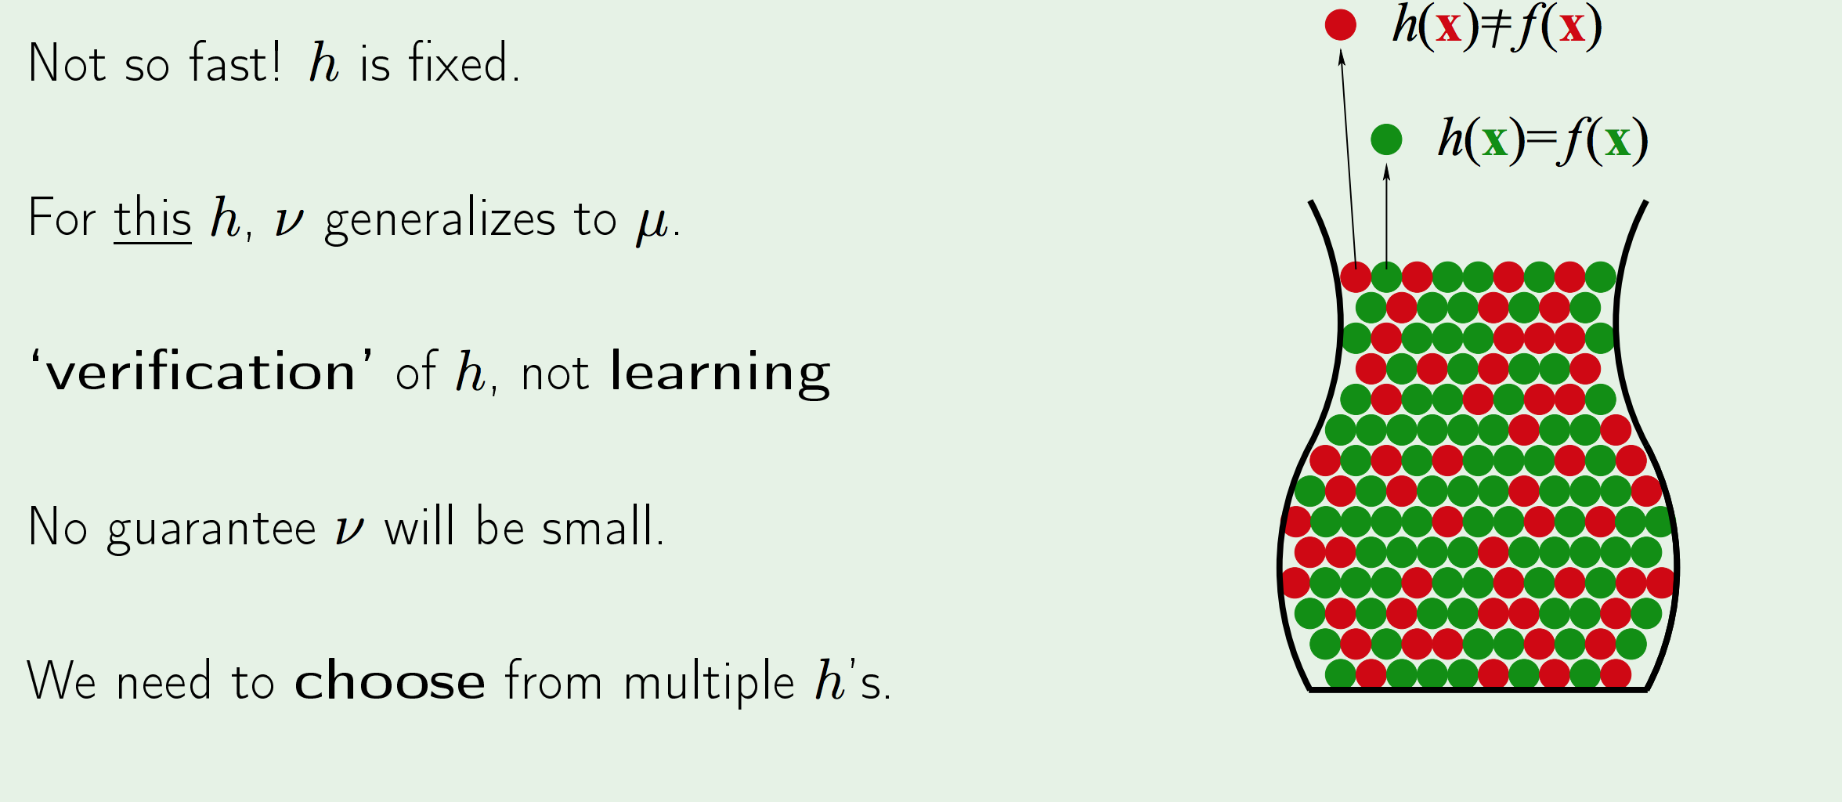
Hoeffding’s Inequality :Are we done?

Slide 22
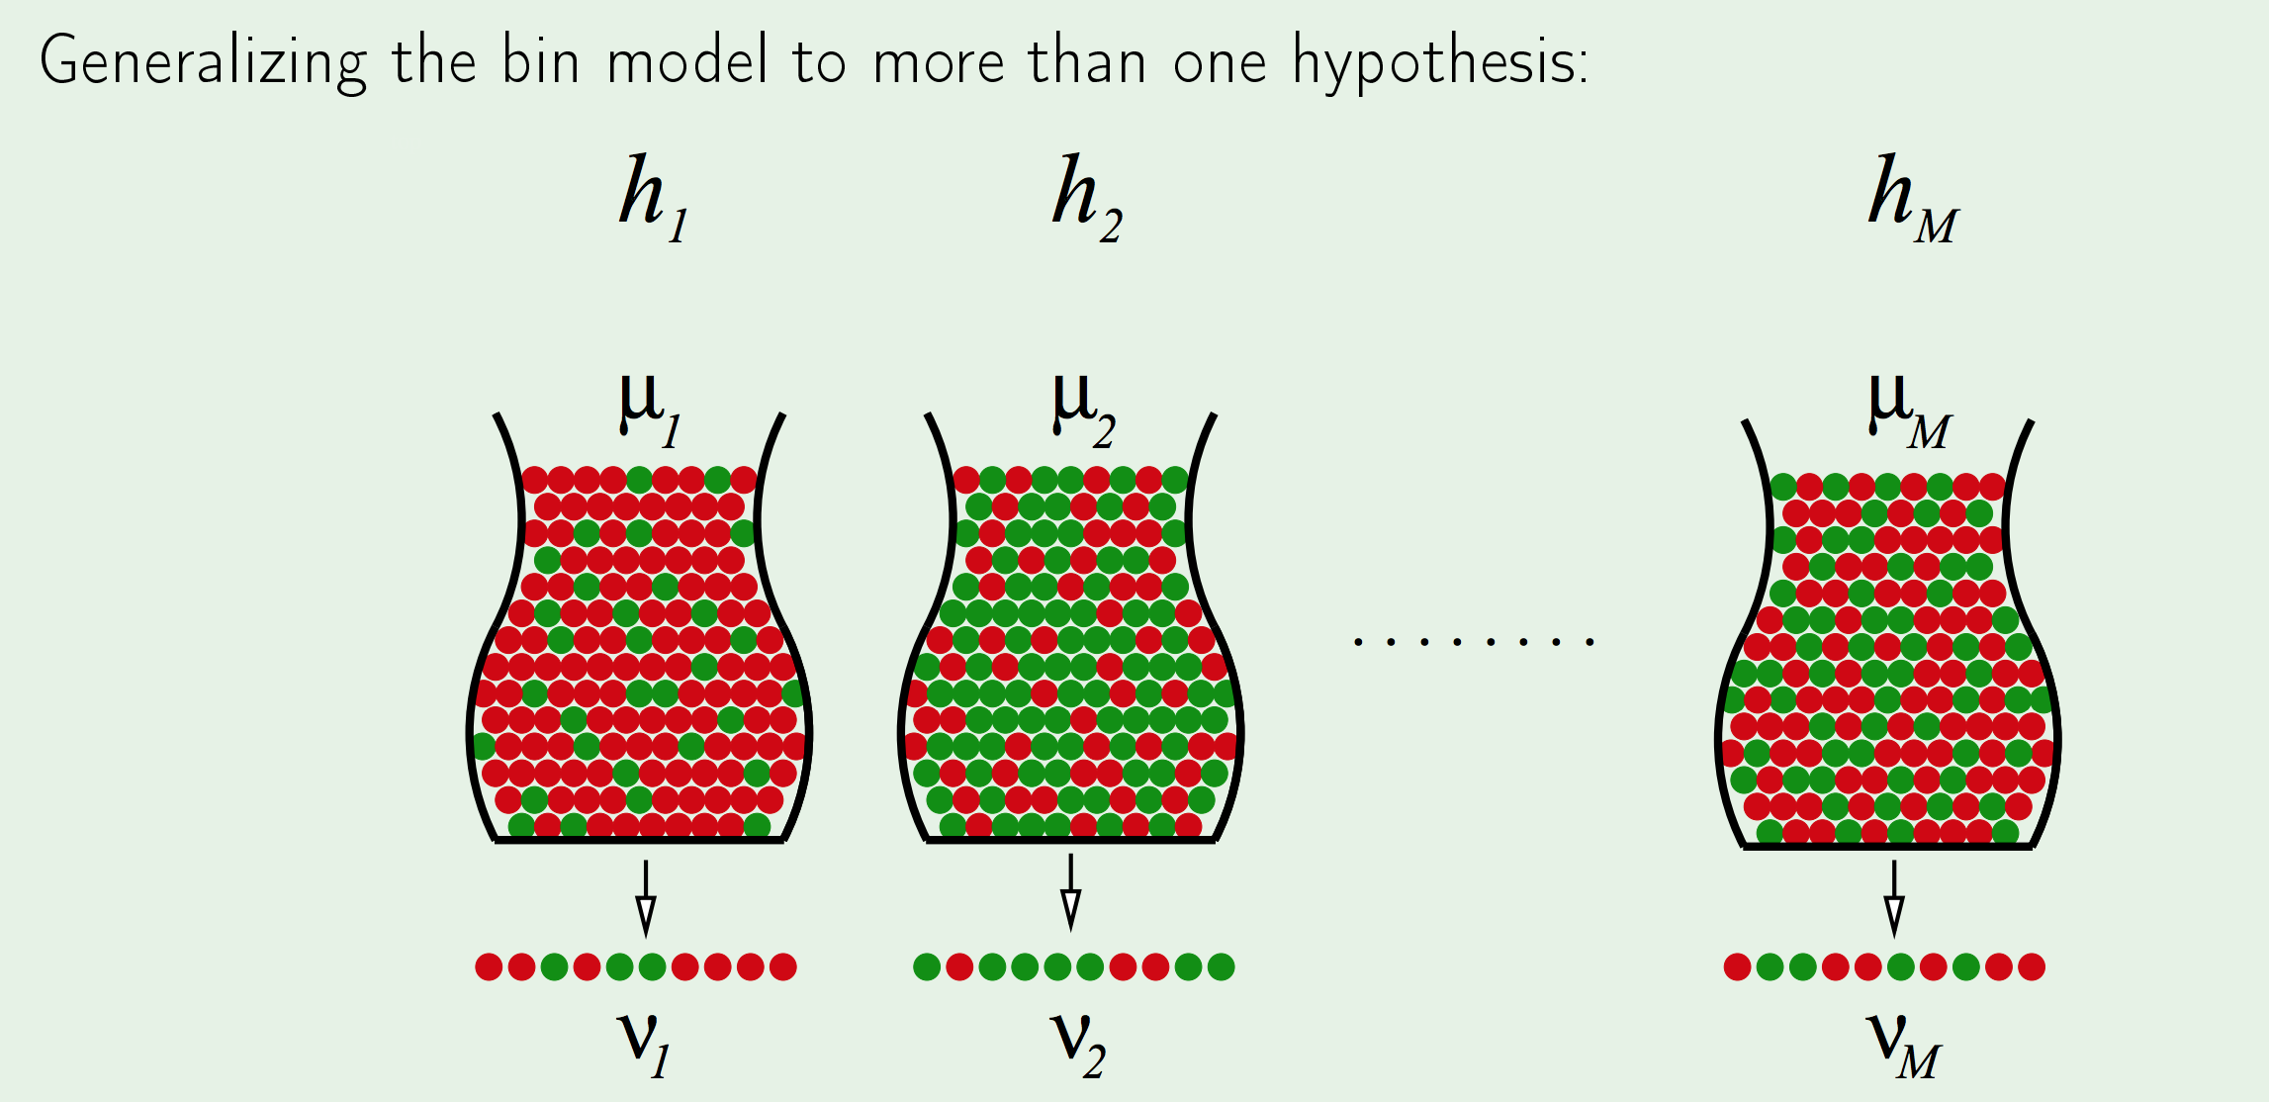
Hoeffding’s Inequality :Multiple bins

Slide 23
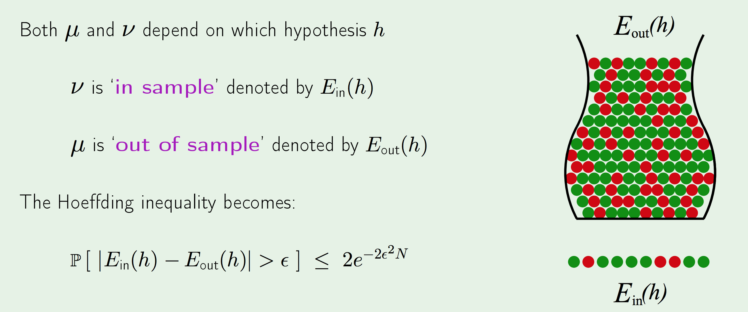
Hoeffding’s Inequality :Notations for learning

Slide 24
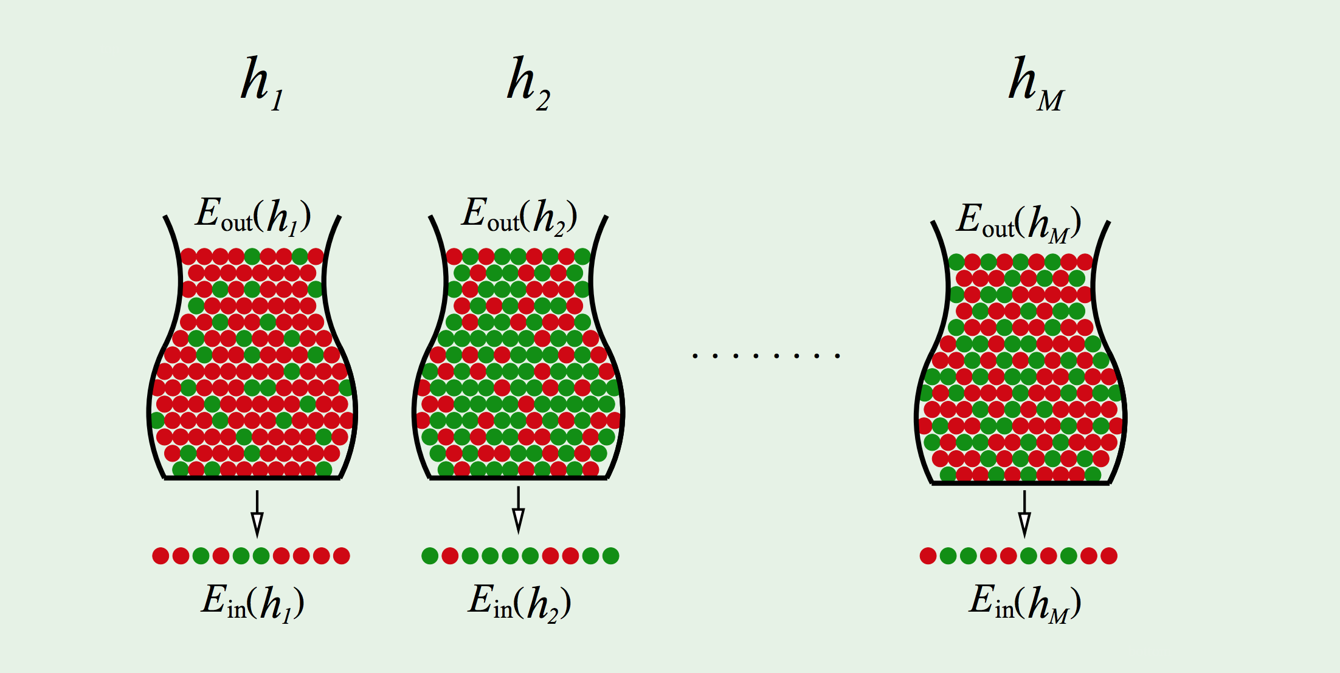
Hoeffding’s Inequality :Notations with multiple bins

Slide 25
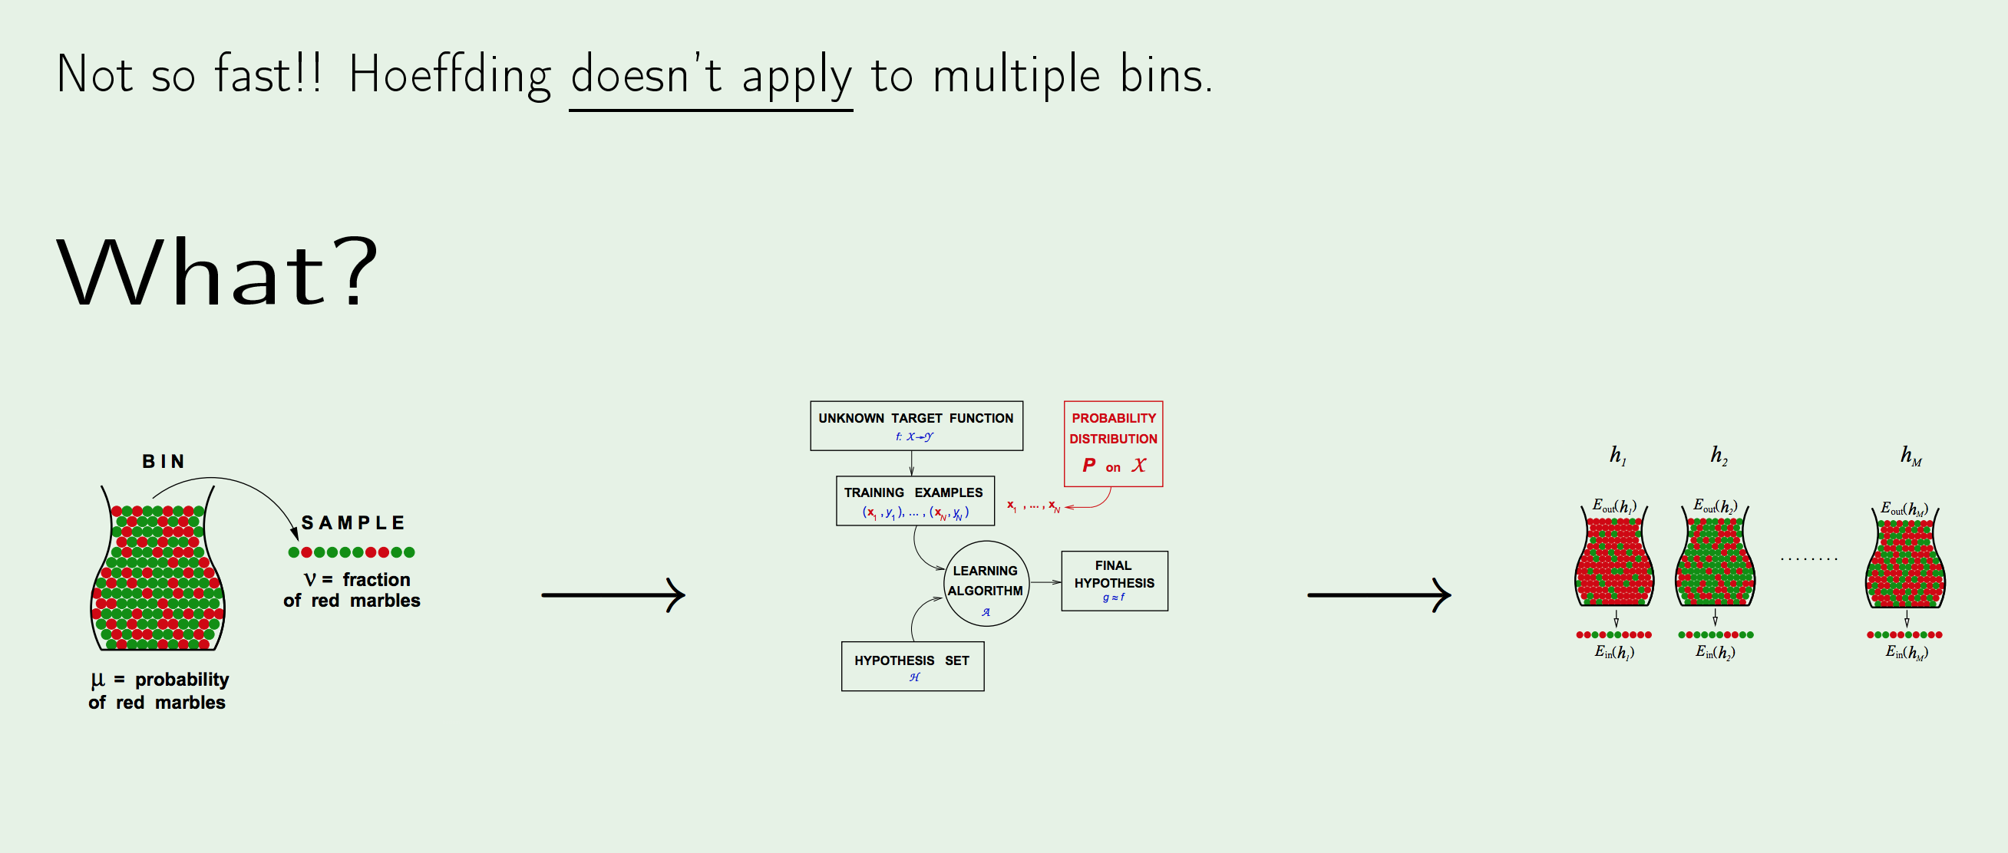
Hoeffding’s Inequality :Are we done already?

Slide 26
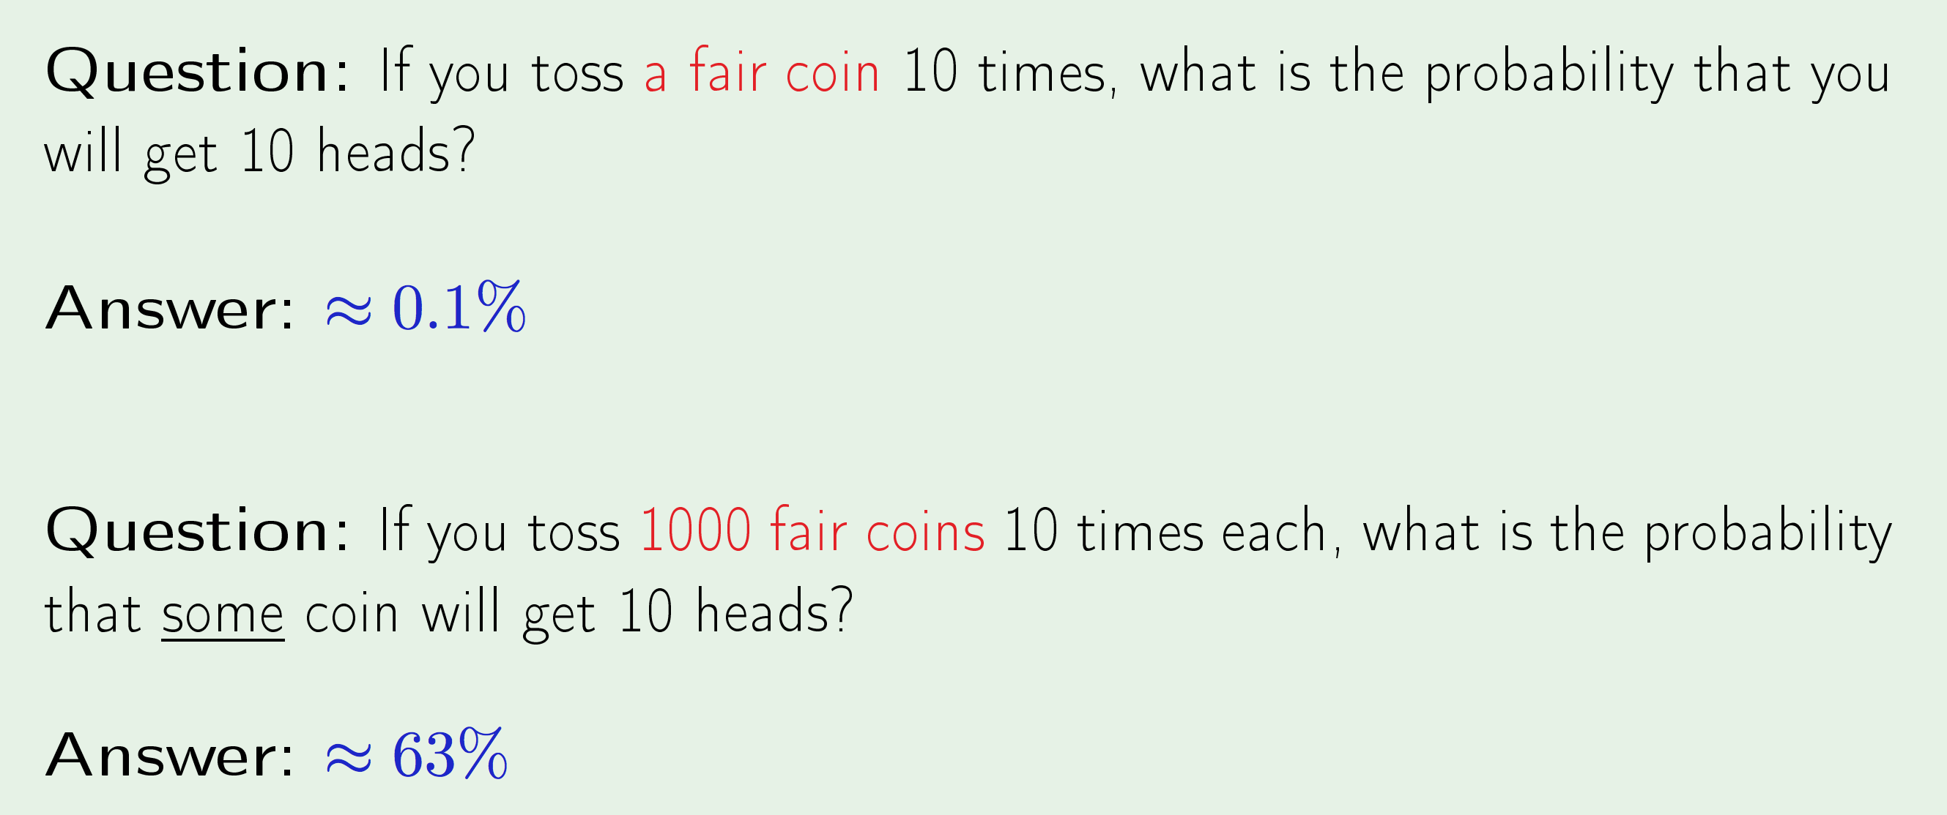
COIN ANALOGY

Slide 27
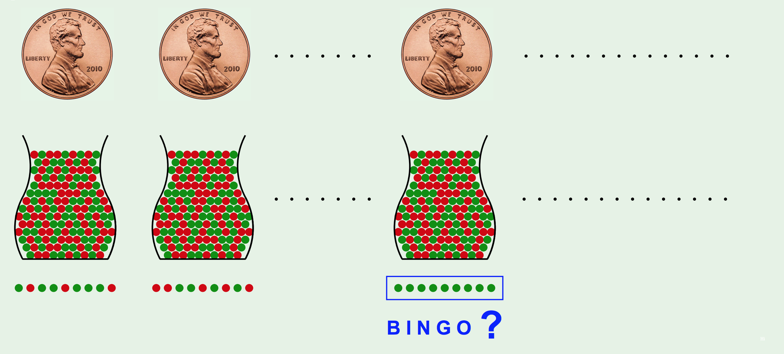
Hoeffding’s Inequality : Multiple bins

Slide 28
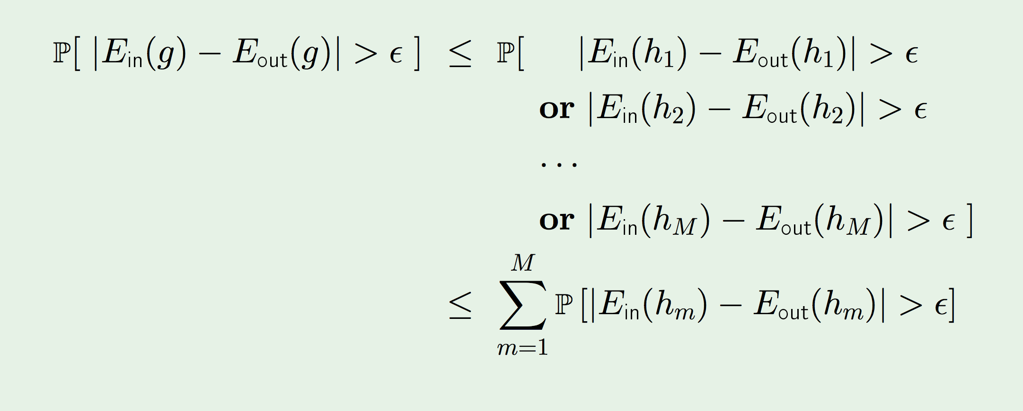
Hoeffding’s Inequality : Multiple bins

Slide 29
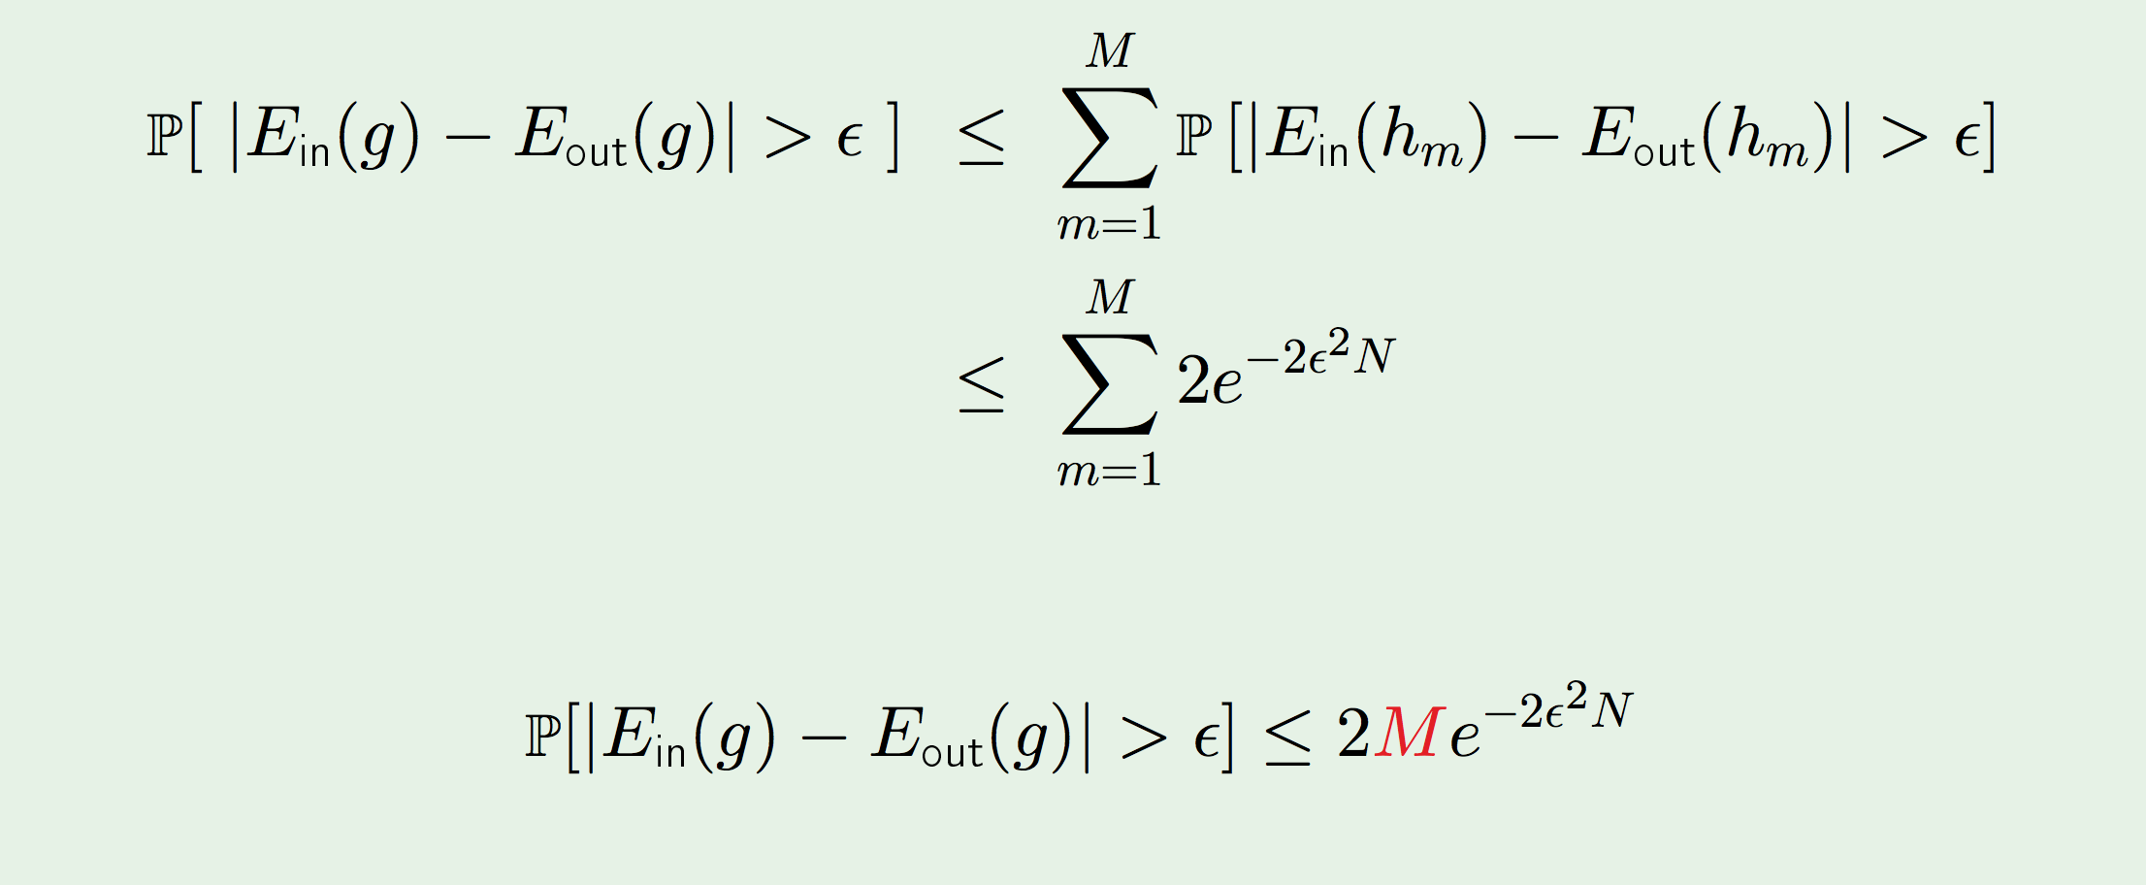
Hoeffding’s Inequality : Multiple bins

